Slide 1
HISTORY OF VIDEO GAMES

Slide 2
WHAT IS A VIDEO GAME?
A video game is an electronic game that has an interface designed for human interaction on a video device.
Video games are used by scientists,the military and people like us.
Their evolution has spread across consoles,computers,smart phones and other electronic devices.

Slide 3
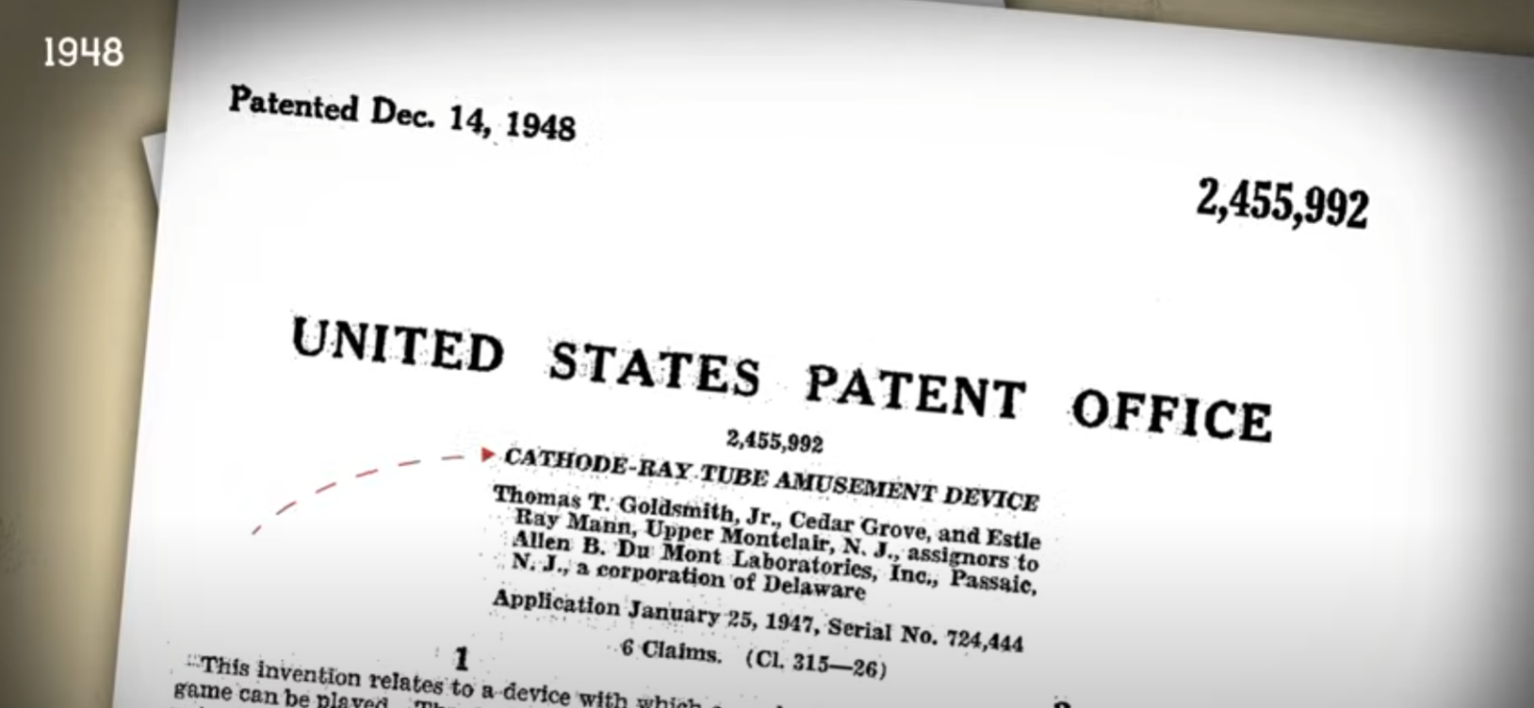
WHERE IS THE ORIGIN OF VIDEO GAME?
The video games can be seen everywhere today, but they were made at first in the science labs.
The earliest video game patent was for a missile simulator game based on the radar displays from the WW II in 1948.

Slide 4
EARLIEST VIDEO GAMES
Some of the earliest video games are:
NIMROD (1951) computer weighted over a ton.
OXO (1952) Tic-tac-toe.
Tennis for Two (1958).
Space War (1961) cost over $100000
But none of these early video games were ever sold to the public because they were either too huge or too expensive to get out of the lab.

Slide 5

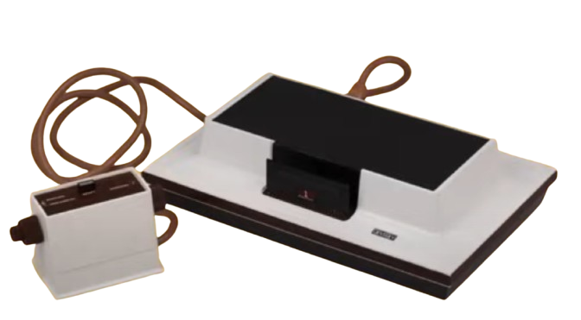
FATHER OF VIDEO GAMES
Ralph Baer is known as the “father of video games”
In In 1972, Baer's idea to get video games out of the science lab and into the living room led to the release of a game console called Odyssey.
Odyssey allowed
you to play a
game on your
TV.

Slide 6
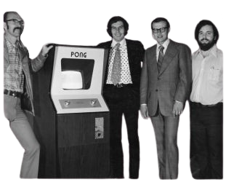

RISE OF ATARI
Nolan Bushnell is the founder of Atari
At about the same time, two other people, Nolan Bushnell and Ted Dabney, were working on something similar in a little company called Atari.

Slide 7
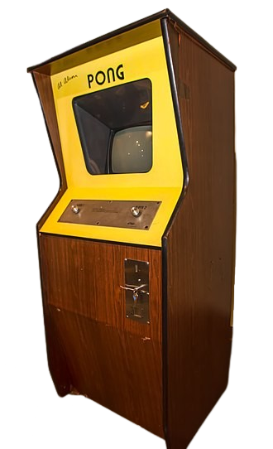
ATARI’s FIRST GAME
Atari's first major game release was in 1972, an arcade game called Pong.
It was an immediate hit, and it's credited as the first commercially successful video game.
Atari then released a home version of Pong in 1974.

Slide 8



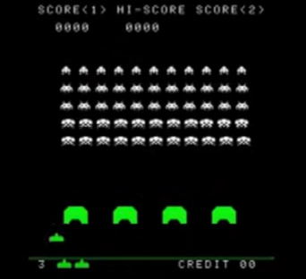
BY 1978
By 1978, competition between Atari and another game company called Midway was heating up.
Midway had licensed an arcade game for the Japanese company, Taito to release the game
SPACE INVADERS.
Became the second highest
selling arcade game of all time.
Space Invaders also helped kick off
what is known as the
Golden Age of Arcade Games.

Slide 9

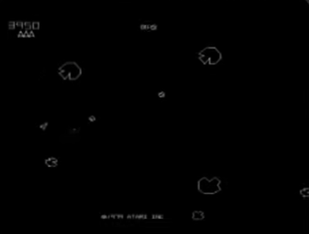
IN RESPONSE TO SPACE INVADERS
In response, Atari followed with the release of the arcade game ASTEROIDS (1979), which ranked sixth on the list of highest selling arcade games.

Slide 10


COLOR TO ARCADE GAMES
By 1980, color came to arcade games, and this was also the year that another video gaming milestone was born.
Pac-Man, created by the Japanese company Namco, was brought to the U.S. by Midway.
Pac-Man was originally called Puck-Man In just a year, Pac-Man arcade games made over one billion dollars in quarters.

Slide 11


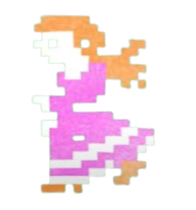


NINTENDO
Then, in 1981, a company called Nintendo started making waves in the U.S. video game market with their release of Donkey Kong.
It was the earliest video game to have a story line.
Donkey Kong is the pet of a carpenter named Jumpman.Jumpman mistreats his pet ape, so the ape steals his girlfriend,leaving the game player to assume the role of Jumpman and rescue the girl.
Jumpman was eventually renamed to Mario.

Slide 12
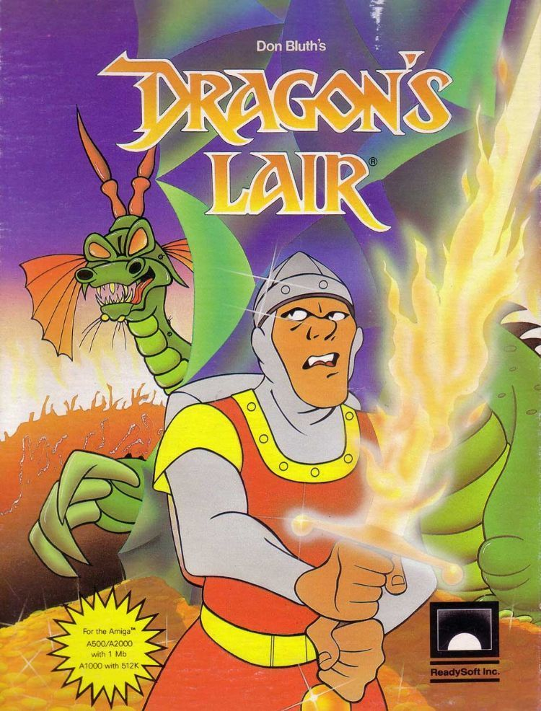
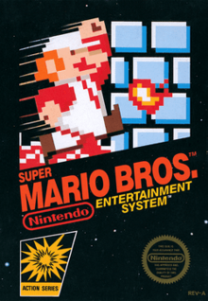
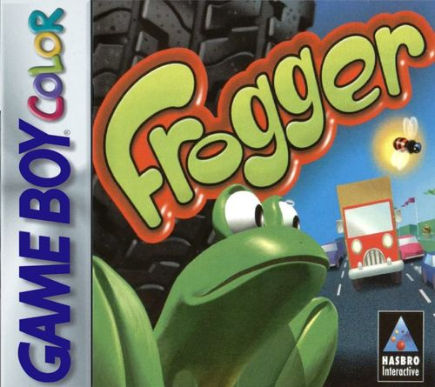
ICONIC ARCADE GAMES
Other iconic arcade games from the early 80s include
Frogger Dragon's Lair Mario Brothers

Slide 13
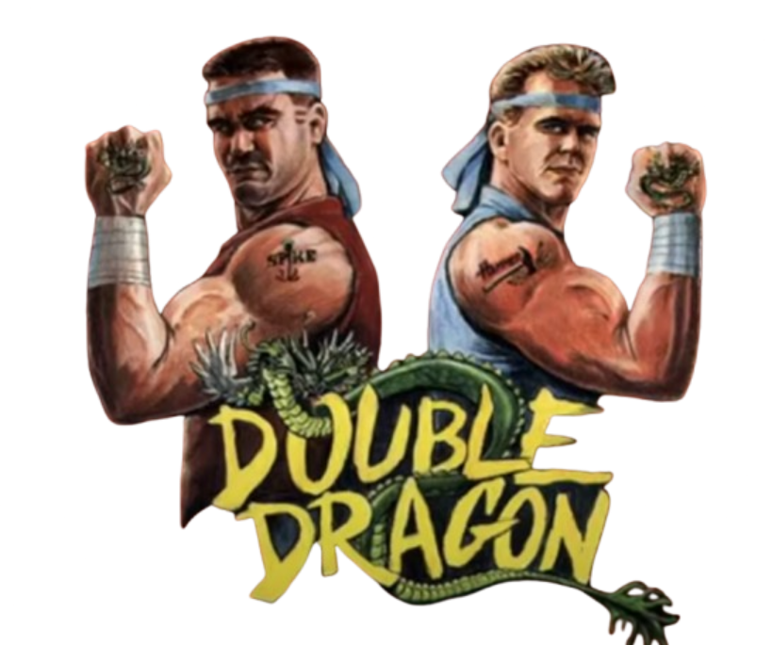
ICONIC ARCADE GAMES
Perhaps the last iconic game considered to be part of the Golden Age of Arcade Games is Double Dragon.
It was the first really successful example of
the beat-them-up genre.
It was released in 1987.
Like Donkey Kong,it featured a damsel in
distress storyline,a storyline common in many video games.
By the mid-90s, the Golden Age of Arcade Games was coming to an end, and the home game console was gaining in popularity.

Slide 14

AI GAMEPLAY
In 2013, a group of researchers at DeepMind in London had set their sights on a grand challenge.
They wanted to create an AI system that could beat, not just a single Atari game, but every Atari game.
They developed a system they called Deep Q Networks, or DQN, and less than two years later, it was superhuman.
DQN was getting scores 13 times better than professional human games testers at “Breakout,”
17 times better at “Boxing,” and 25 times better at “Video Pinball.”

Slide 15
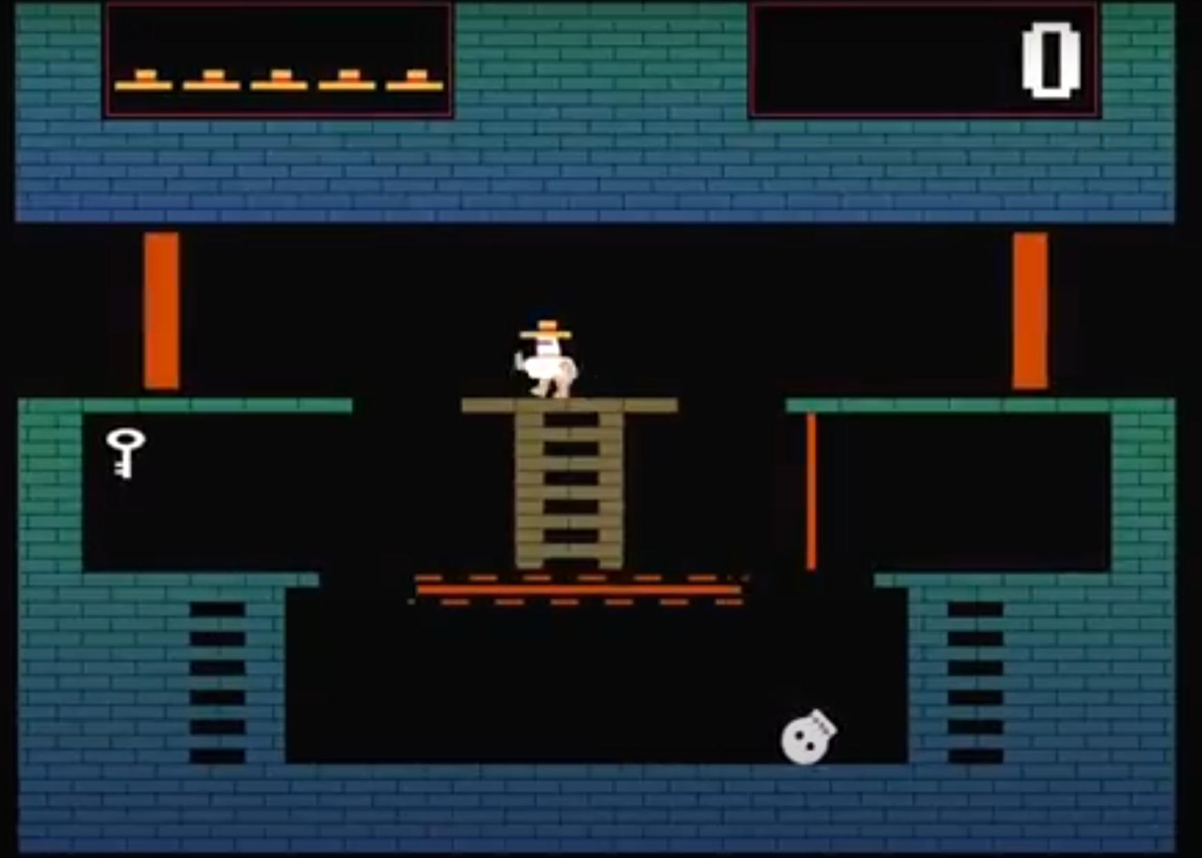
AI problems
When playing “Montezuma’s Revenge” DQN couldn’t score a single point, even after playing for weeks.

Slide 16
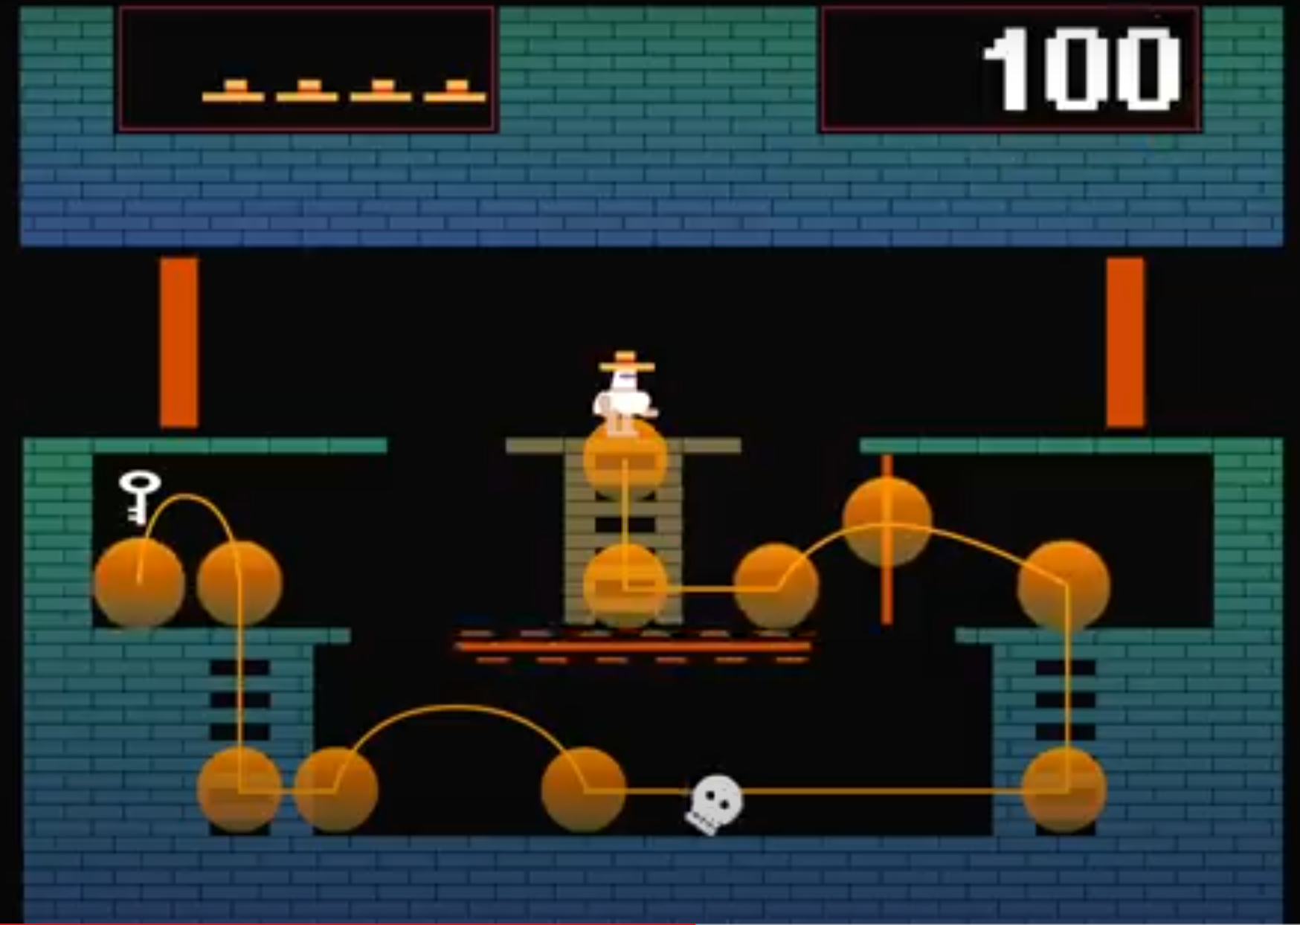

Slide 17
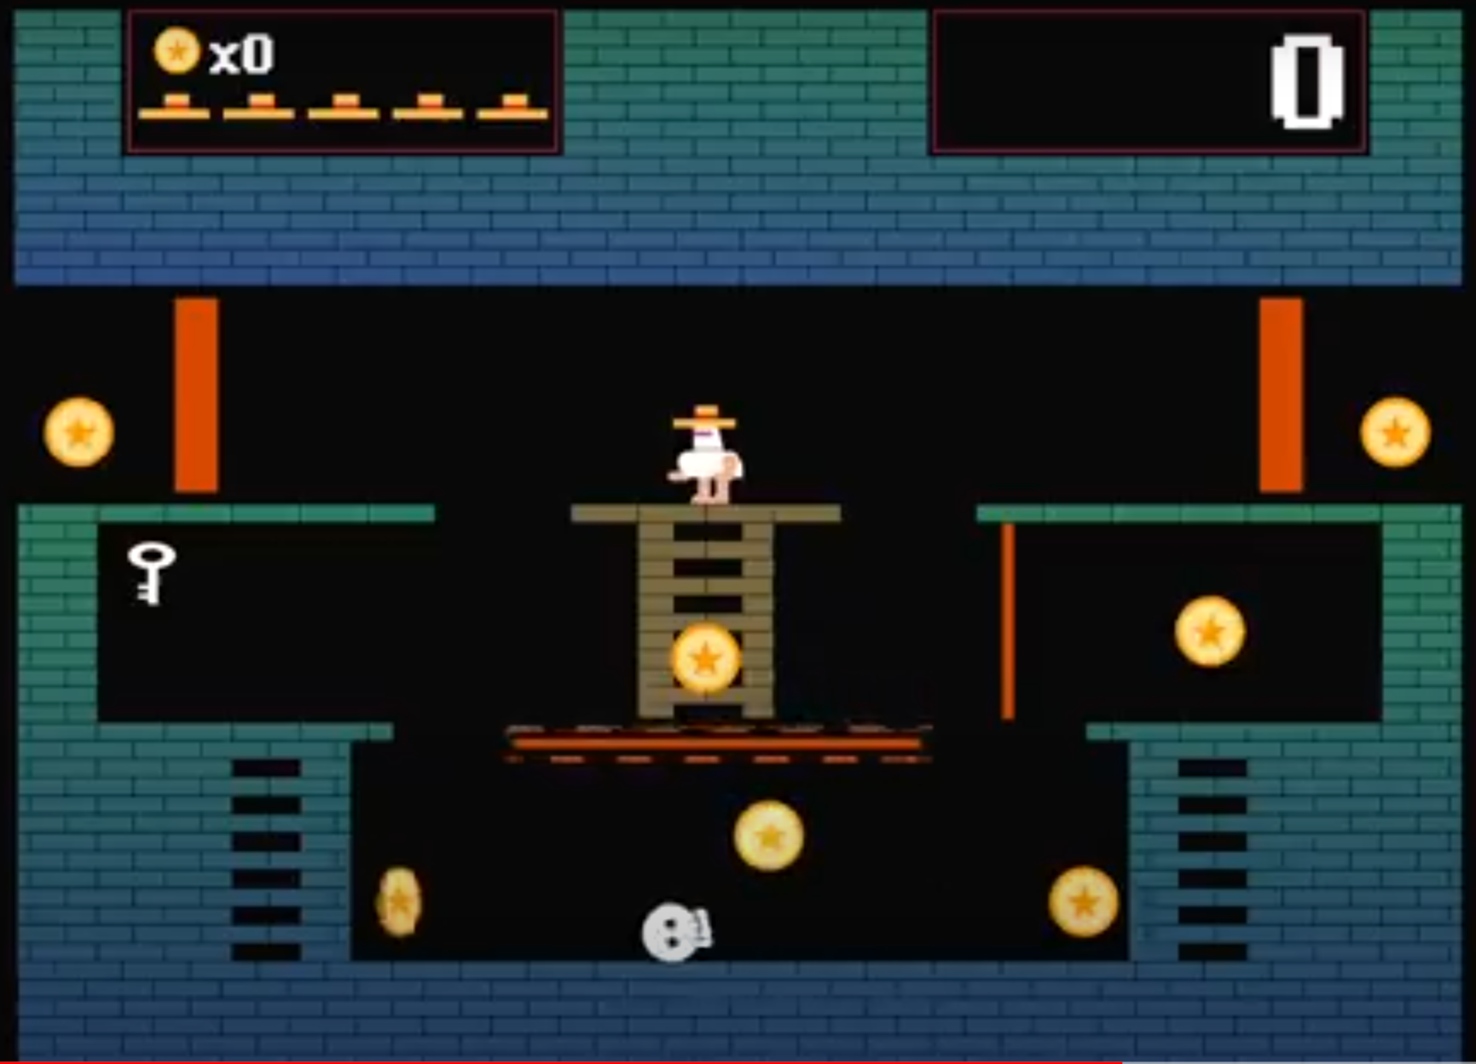

Slide 18
Thank you

